Slide 1
FAIR USE NOTICE
The material used in this presentation i.e., pictures/graphs/text, etc. is solely intended for educational/teaching purpose, offered free of cost to the students for use under special circumstances of Online Education due to COVID-19 Lockdown situation and may include copyrighted material - the use of which may not have been specifically authorised by Copyright Owners. It’s application constitutes Fair Use of any such copyrighted material as provided in globally accepted law of many countries. The contents of presentations are intended only for the attendees of the class being conducted by the presenter.

Slide 2
CLOUD COMPUTING
LECTURE 01-05
Notes:
2

Slide 3
CONTENTS
Cloud Computing
Characteristics of Cloud Computing
Why Cloud Computing?
Evolution of Cloud Computing
Service Models
Deployment Models
Drawbacks

Slide 4
COMPUTING
Originally, the word computing was synonymous with counting and calculating, and a science that deals with the original sense of computing mathematical calculations but now it has come to mean the operation and usage of computing machines, the electrical processes carried out within the computing hardware itself, and the theoretical concepts governing them.”
“Calculation or manipulation of data with the computer machines done with different types of computers as microcomputers ( a PC or Laptop, etc), mainframe or supercomputer, nowadays even the mobile devices.”
May be business computing , scientific computing etc.

Slide 5
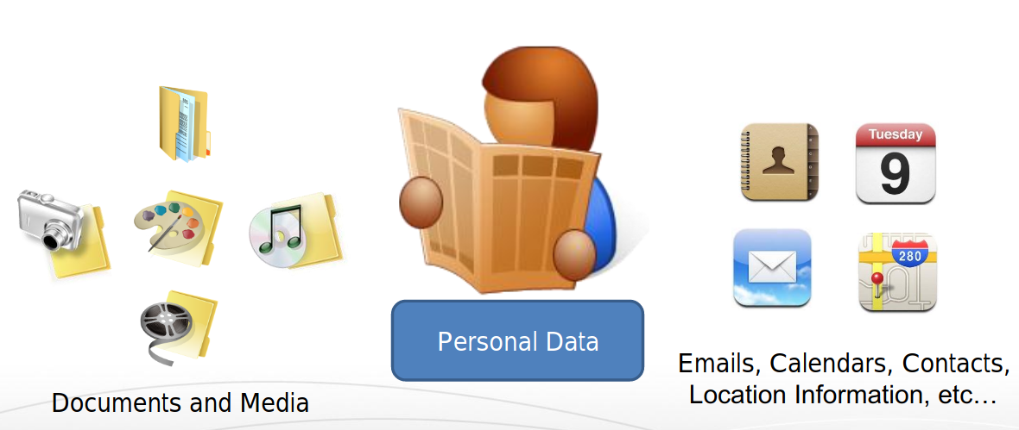
OUR DATA NOW...

Slide 6
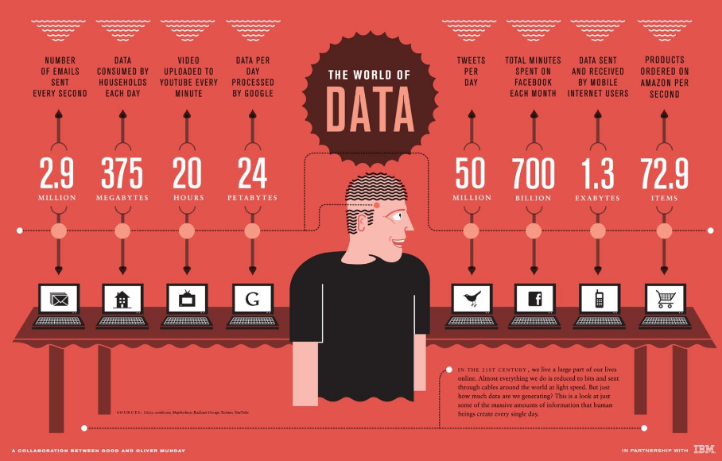

Slide 7
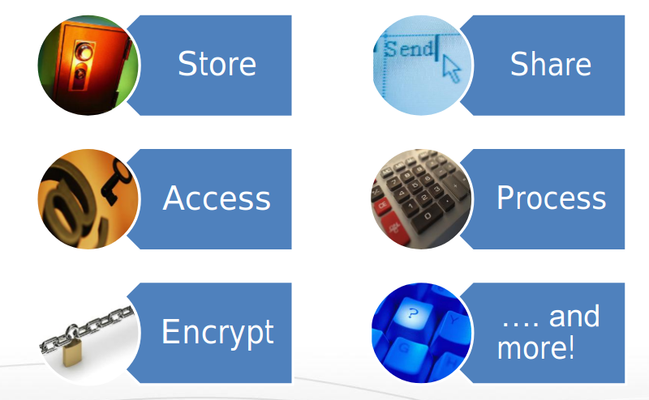
WHAT TO DO WITH THE DATA?
We want to do these seamlessly...

Slide 8
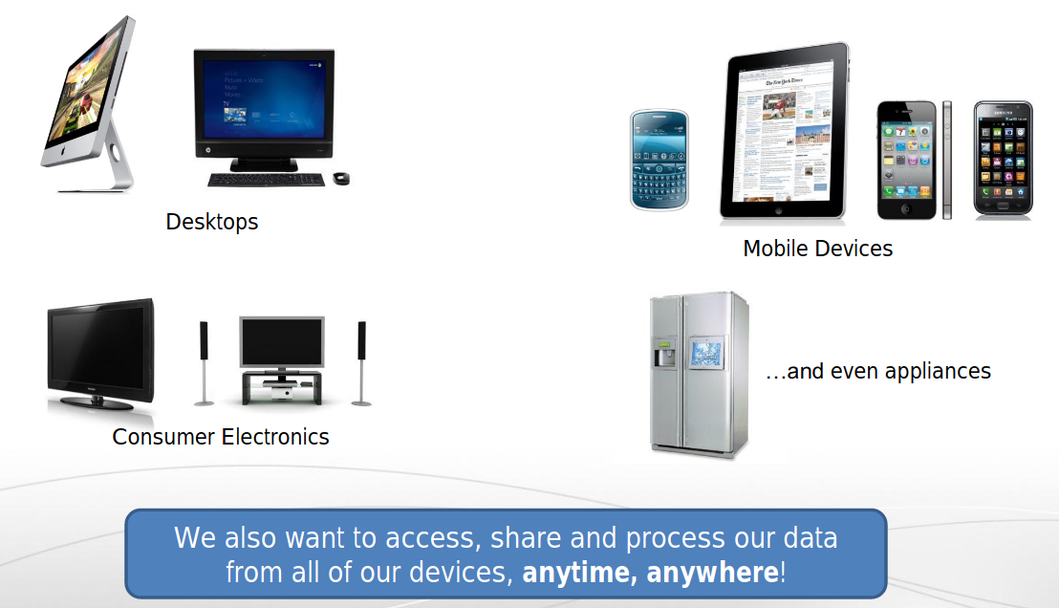
USING DIVERSE DEVICES AND INTERFACES

Slide 9
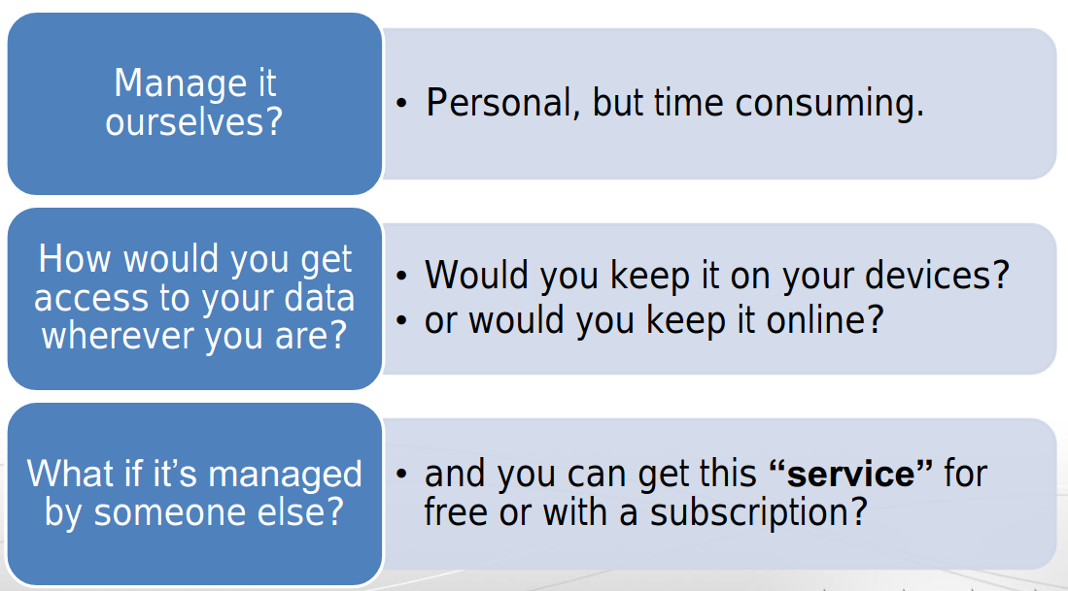
HOW DO WE MANAGE OUR DATA?

Slide 10
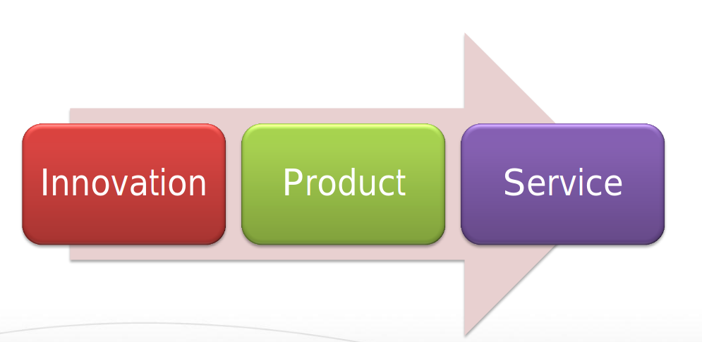
HAS THIS HAPPENED BEFORE?

Slide 11
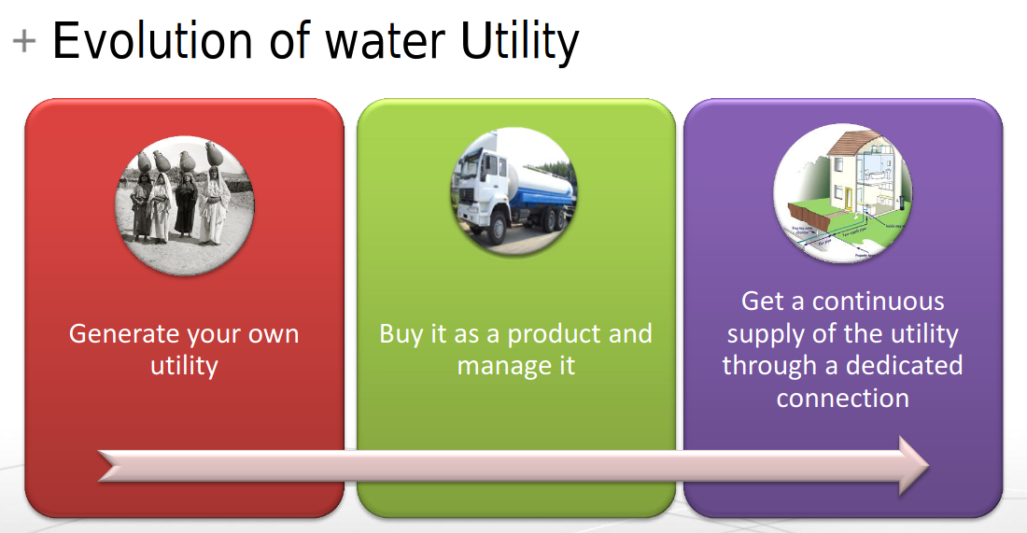
HAS THIS HAPPENED BEFORE?

Slide 12
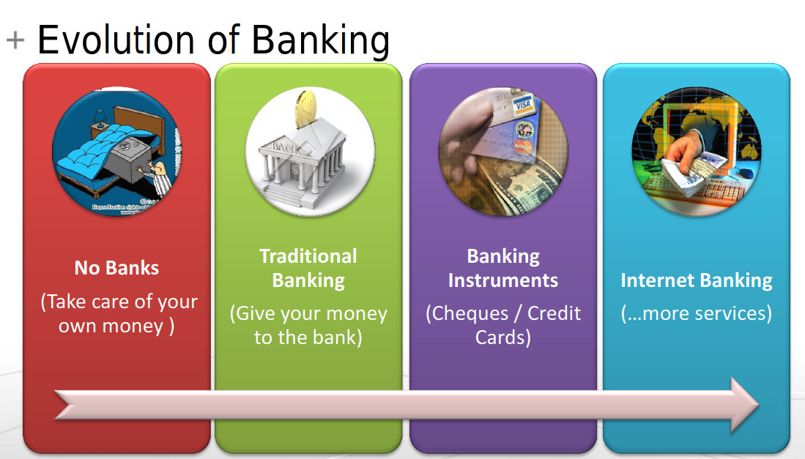
HAS THIS HAPPENED BEFORE?

Slide 13
So What is Cloud Computing?
“Cloud Computing is the transformation of IT from a product to a service”

Slide 14
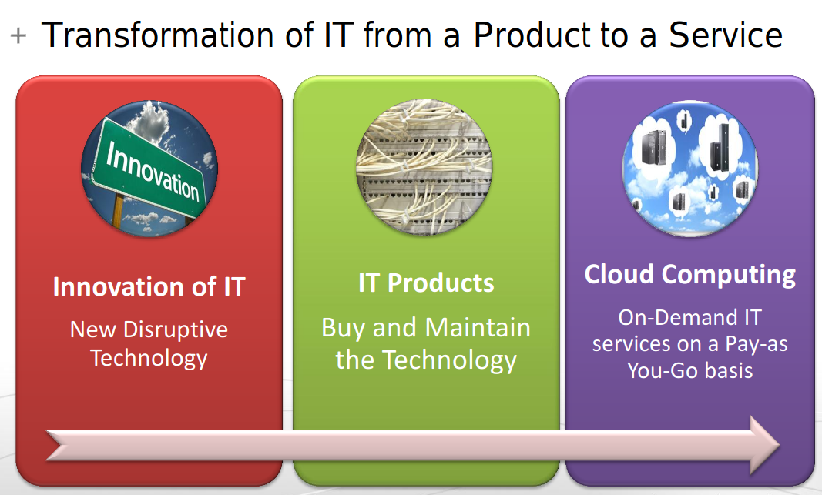

Slide 15
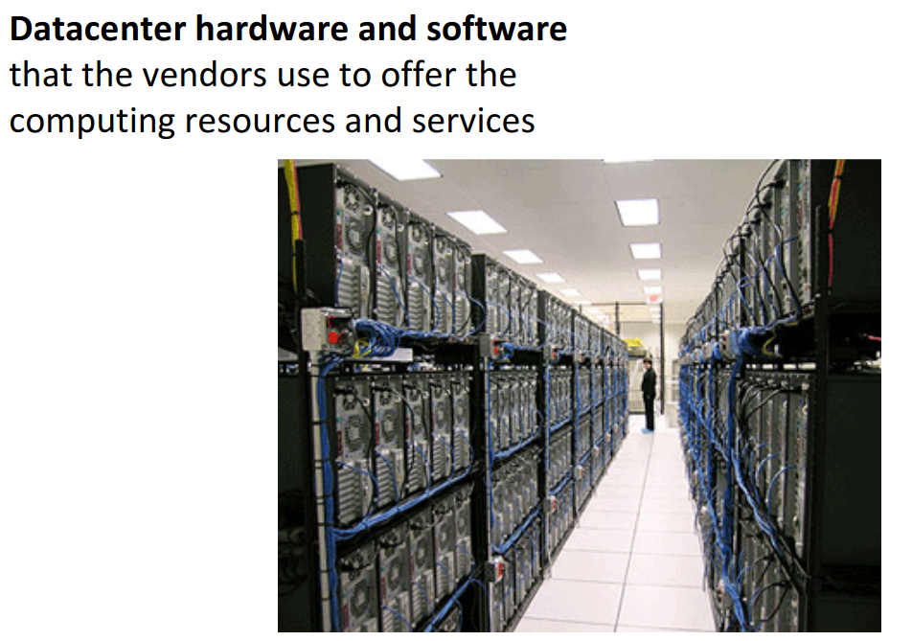
CLOUD IS A..

Slide 16
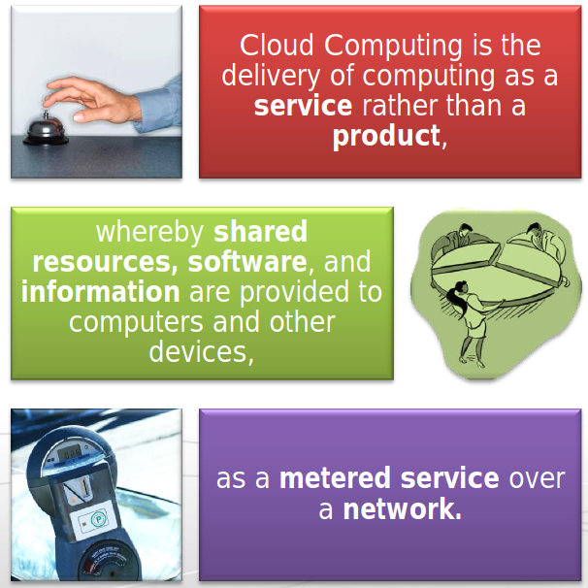

For a more complete definition of cloud computing

Slide 17
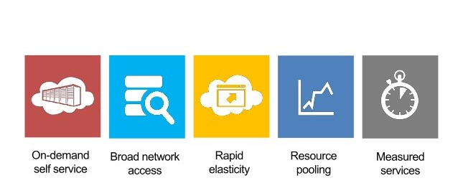
5 ESSENTIAL CHARACTERISTICS OF CLOUD COMPUTING

Slide 18
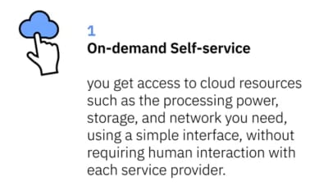
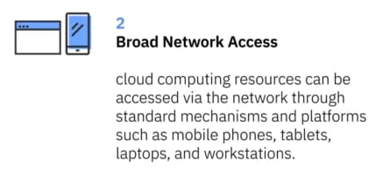
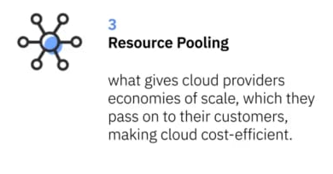
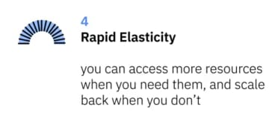
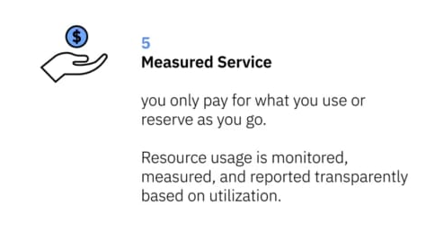
ESSENTIAL CHARACTERISTICS

Slide 19
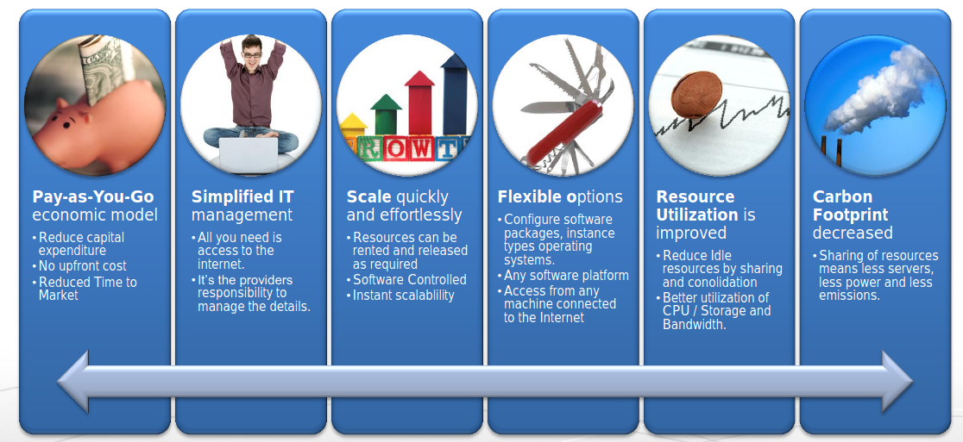
WHY CLOUD COMPUTING?

Slide 20
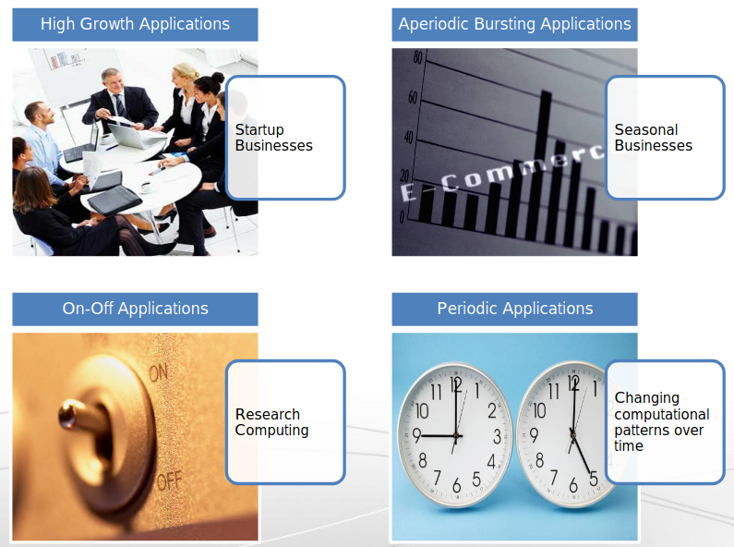
APPLICATIONS ENABLED BY CLOUD COMPUTING?

Slide 21
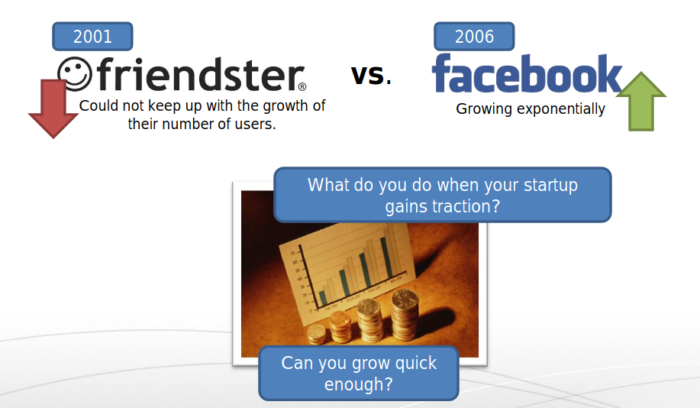
HIGH GROWTH APPLICATIONS

Slide 22
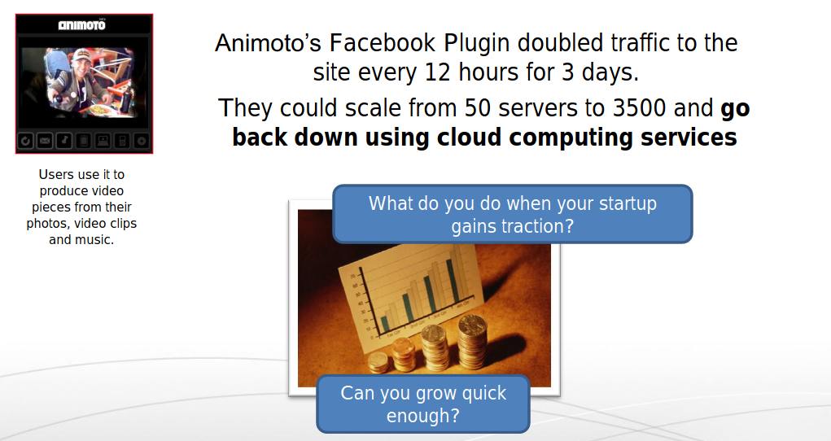
HIGH GROWTH APPLICATIONS

Slide 23
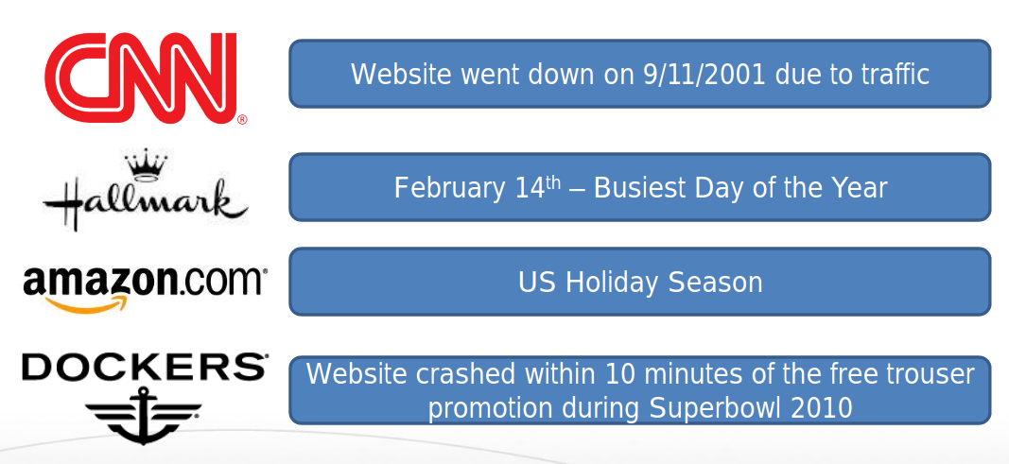
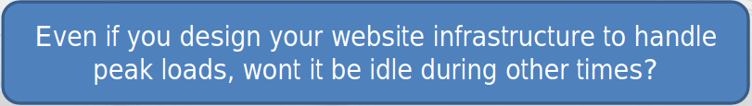
Aperiodic Bursting Applications

Slide 24
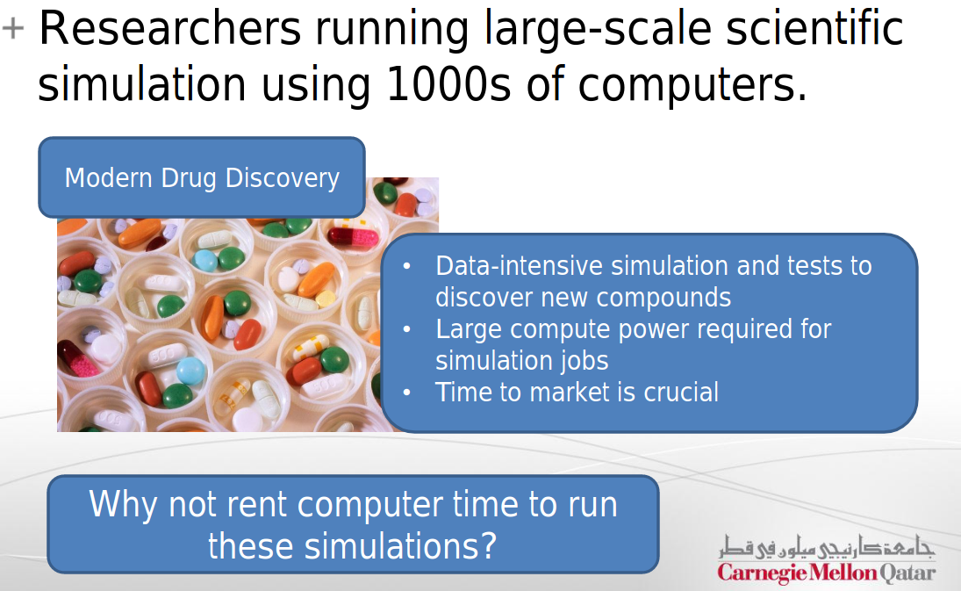
ON-OFF APPLICATIONS

Slide 25
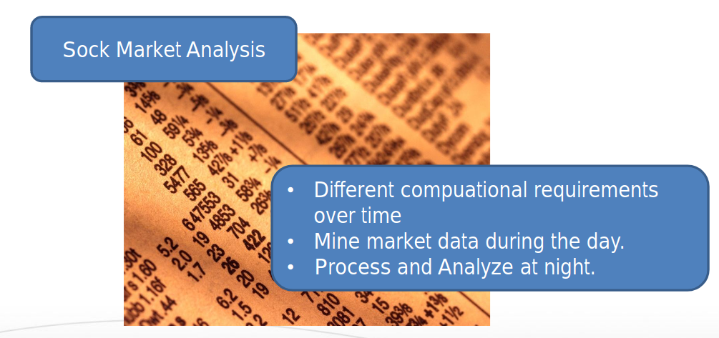
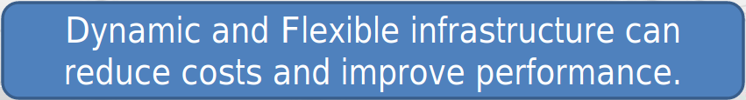
PERIODIC APPLICATIONS

Slide 26
HISTORY & EVOLUTION OF CLOUD COMPUTING

Slide 27
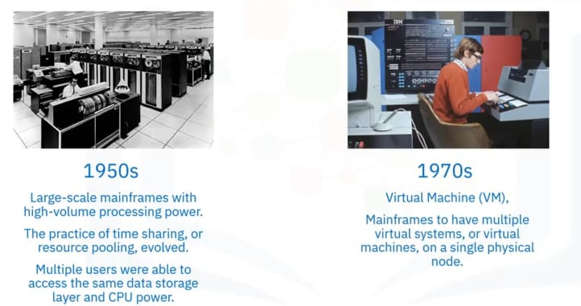

Slide 28
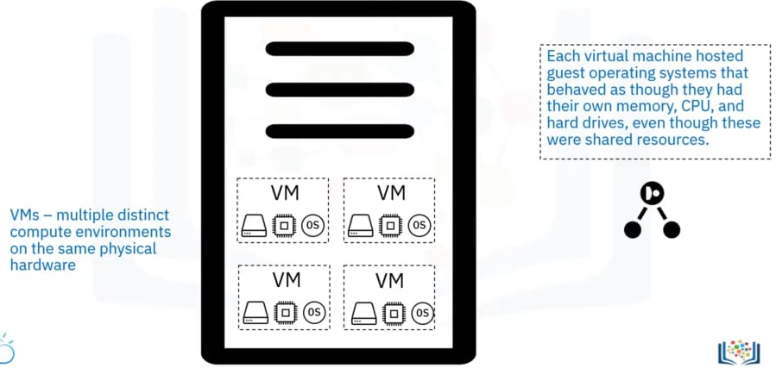
VIRTUAL MACHINES

Slide 29
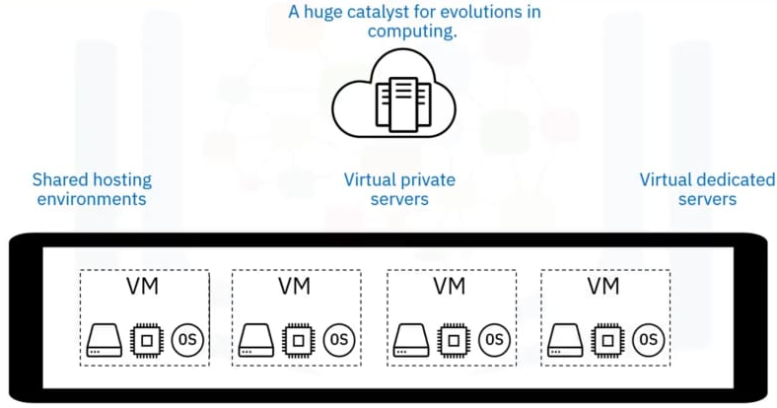
VIRTUALIZATION

Slide 30
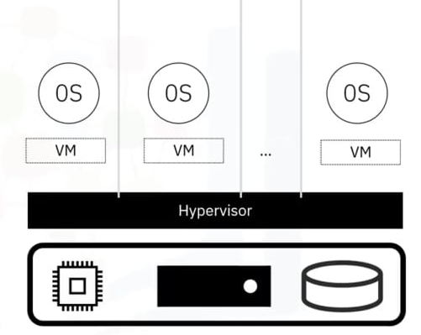
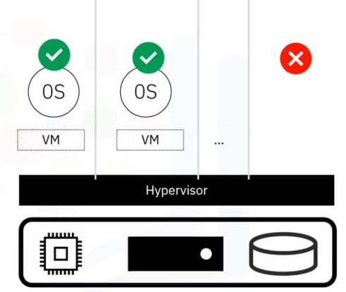
HYPERVISOR

Slide 31
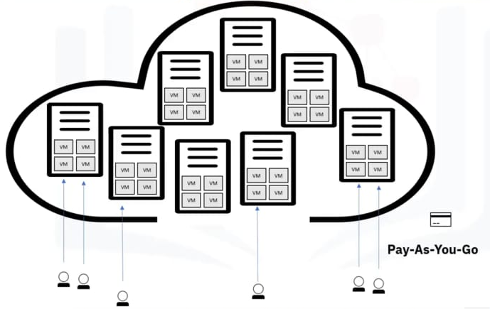

Slide 32
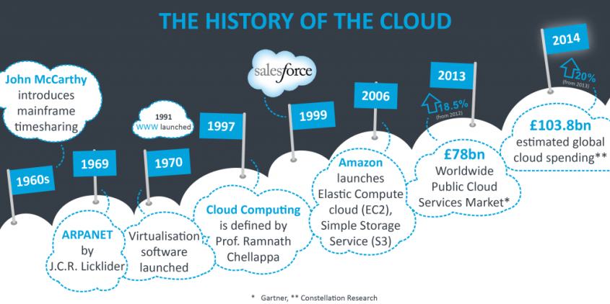

Slide 33
TYPES OF CLOUD COMPUTING

Slide 34
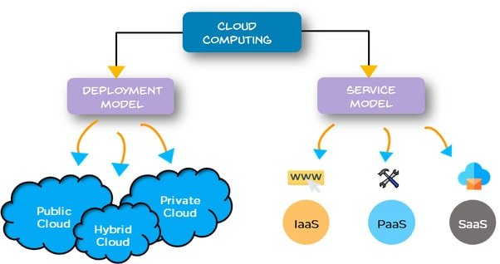

Slide 35
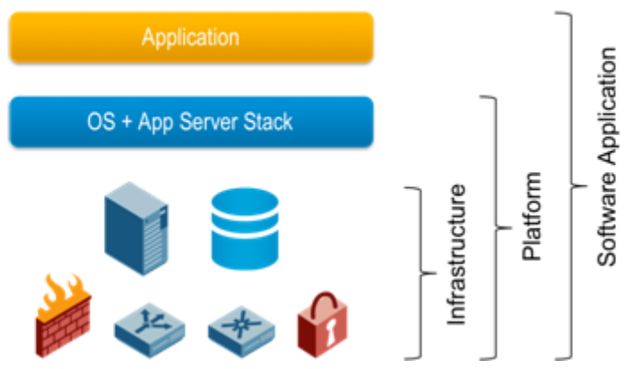
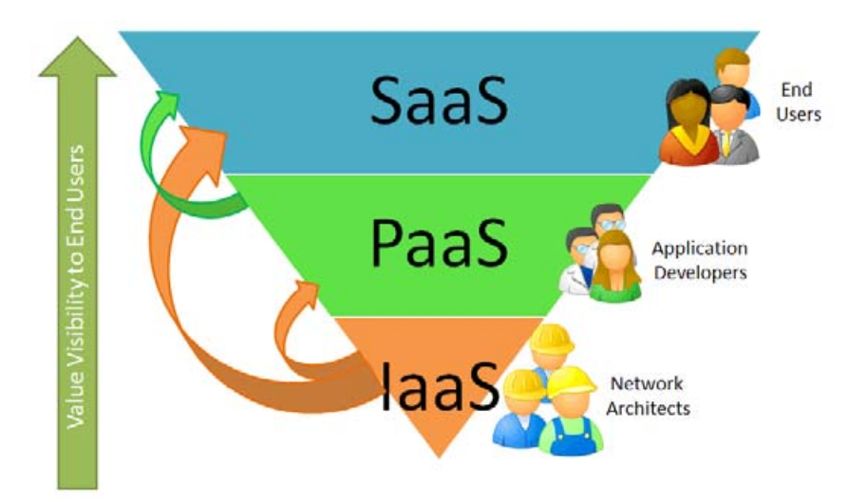
TYPES OF SERVICE MODELS
Three basic services:
Software as a Service (SAAS) model
Apps through browser
Platform as a Service (PAAS) model
Delivery of a computing platform for custom software development as a service
Infrastructure as a Service (IAAS) model
Deliverance of computer infrastructure as a service
XAAS, the list continues to grow...

Slide 36
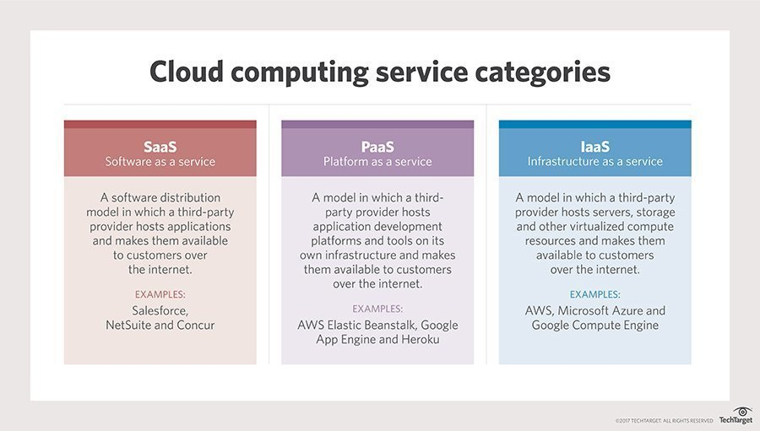

Slide 37
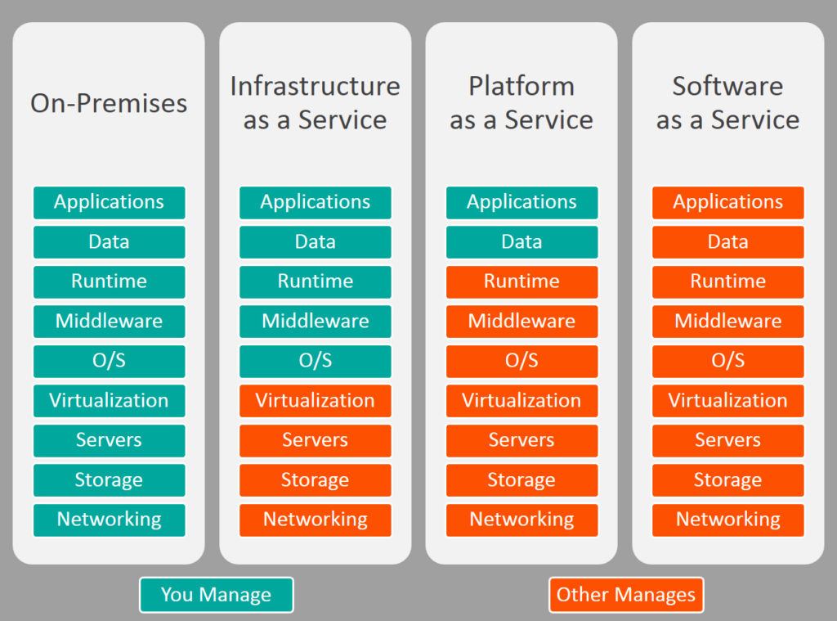

Slide 38
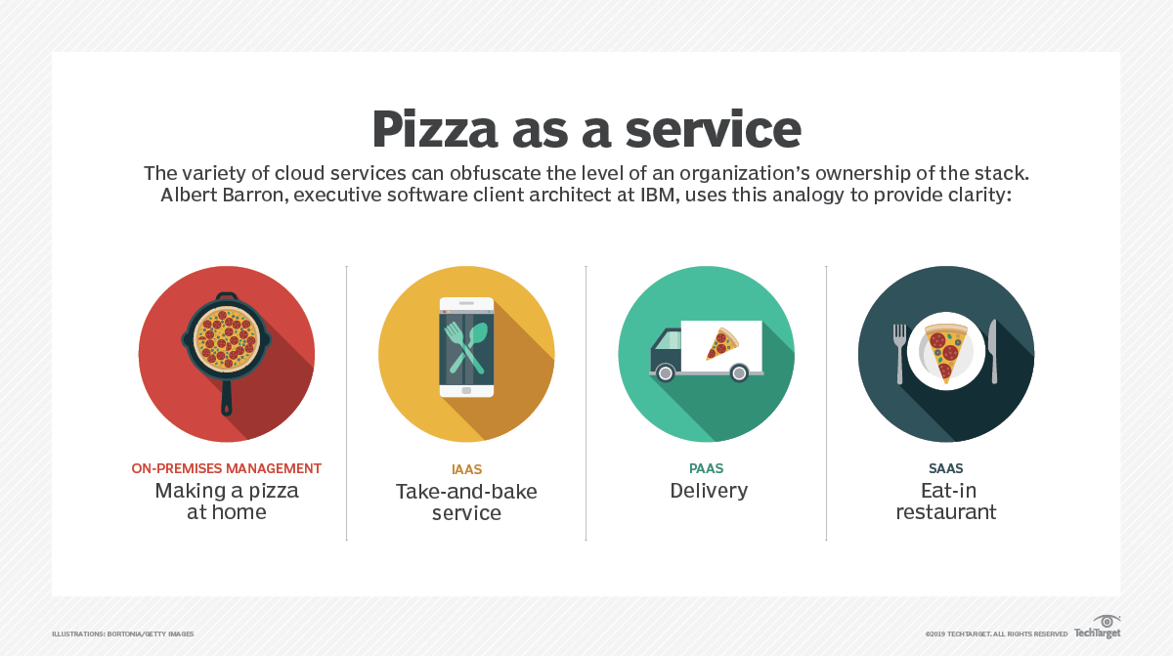

Slide 39
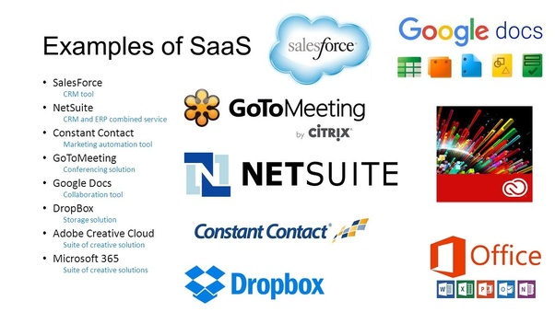

Slide 40
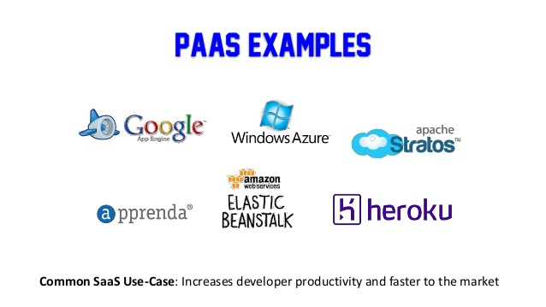
PAAS EXAMPLES

Slide 41
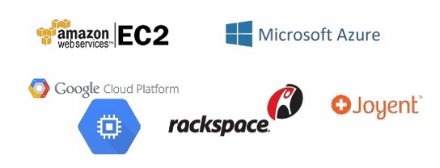
IAAS EXAMPLES

Slide 42
XAAS – Anything/Everything as a Sevice
Desktop: DaaS - Use your desktop virtually from anywhere
Communication: CaaS
Virtualization: VaaS
Hardware: HaaS
...etc

Slide 43
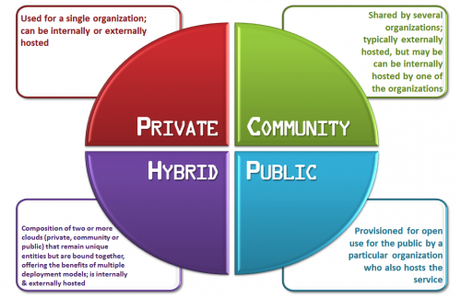
TYPES OF DEPLOYMENT MODELS

Slide 44
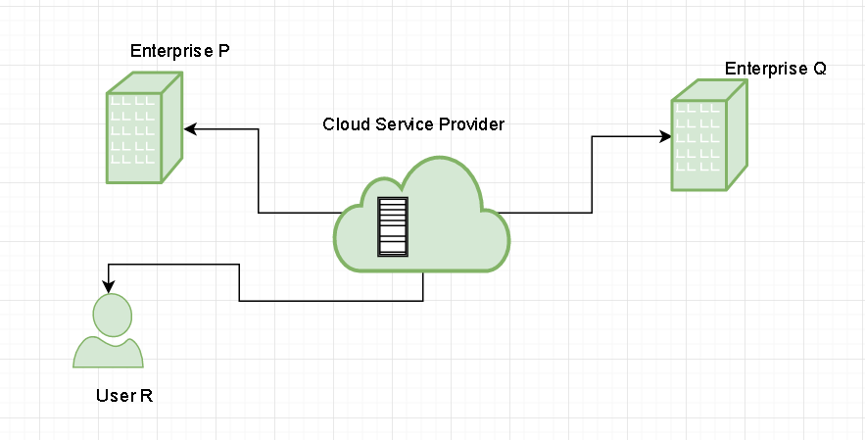
PUBLIC COUD

Slide 45
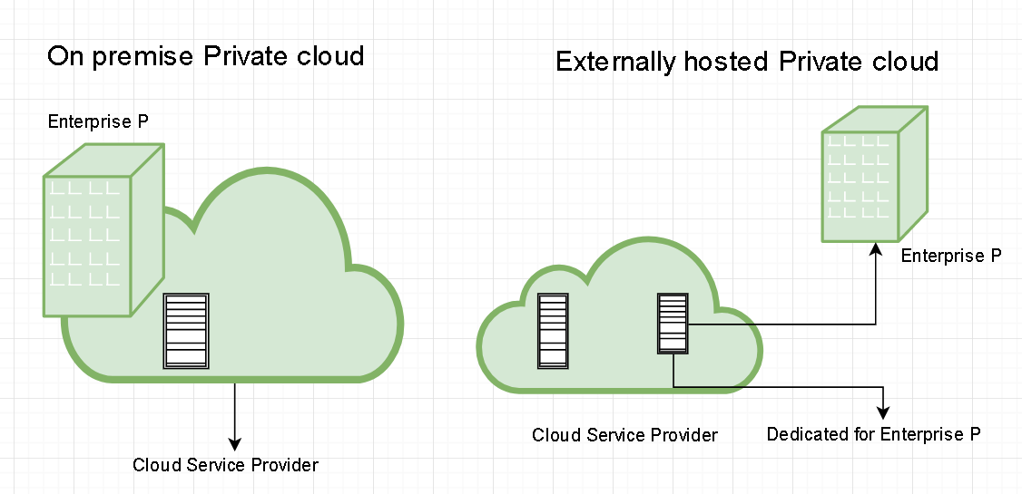
PRIVATE CLOUD

Slide 46
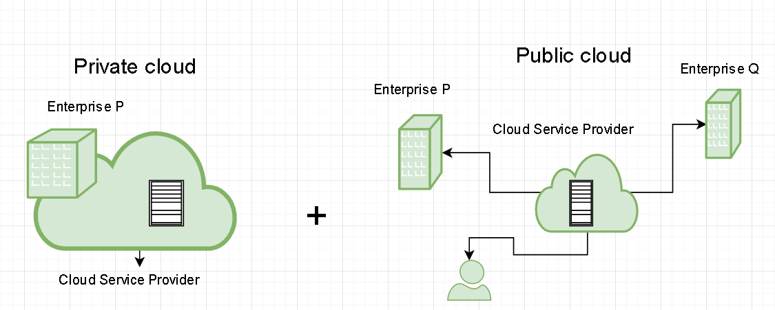
HYBRID CLOUD
A major drawback of private deployments is the inability to scale on demand and to efficiently address peak loads.
Here public clouds are needed. Hence, a hybrid cloud takes advantages of both public and private cloud.

Slide 47
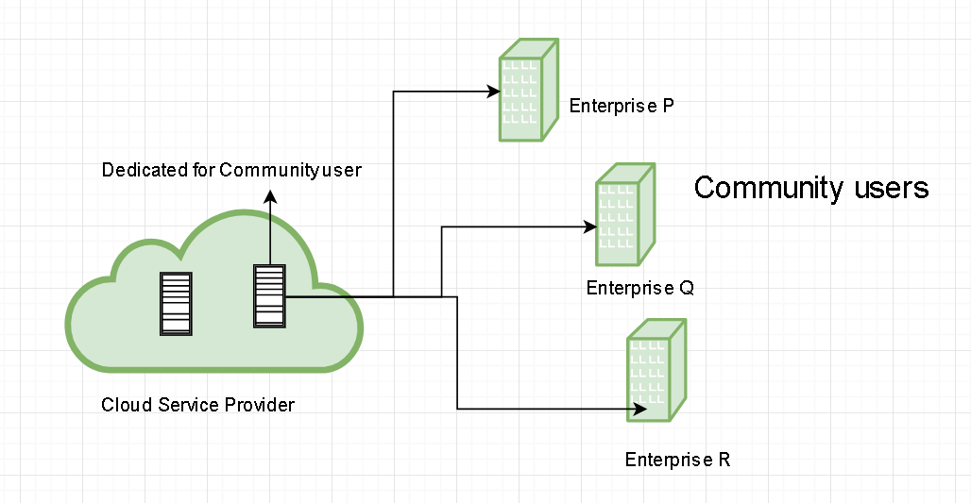
COMMUNITY CLOUD
In community cloud, the infrastructure is shared between organization which have shared concerns or tasks. Such as:
Healthcare industry: In healthcare industry community clouds are used to share information and knowledge on the global level with sensitive data in the private infrastructure.
Scientific research: In this organization with common interests of science share large distributed infrastructure for scientific computing.

Slide 48
DRAWBACKS
Security
Privacy
Vendor lock-in
Network-Dependant
Migration

